Slide 1
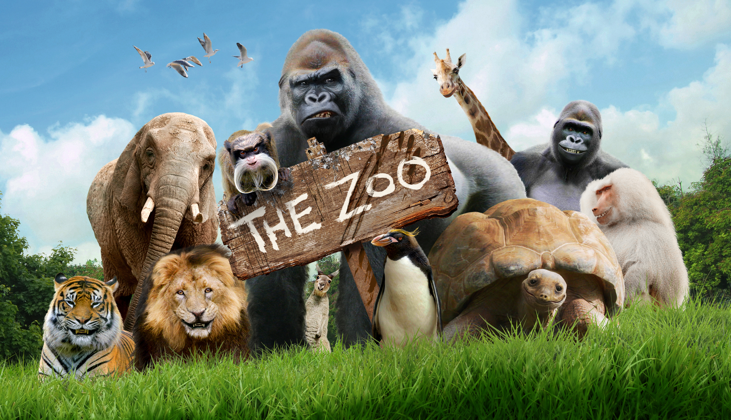
https://www.imdb.com/title/tt7900174/
Notes:
Hello, My name is Seonhye Yoon, and Today I’ll talk about “How can we protect animals right in the zoo and aquariums?”
Has anyone never been to a zoo or aquariums?
Most people visit zoo and aquariums at least once for educational or entertaining purposes.
However, there is a view that the zoo and aquarium is not for animals, but it is abusing them.

Slide 2

https://www.amazon.com/MAGNET-Sticker-Animal-Magnetic-sticker/dp/B07RQCK32V
Notes:
However, can we close all the zoos right away?
No, it's not possible.
So, what can we do for the animals in the zoo and aquarium?

Slide 3
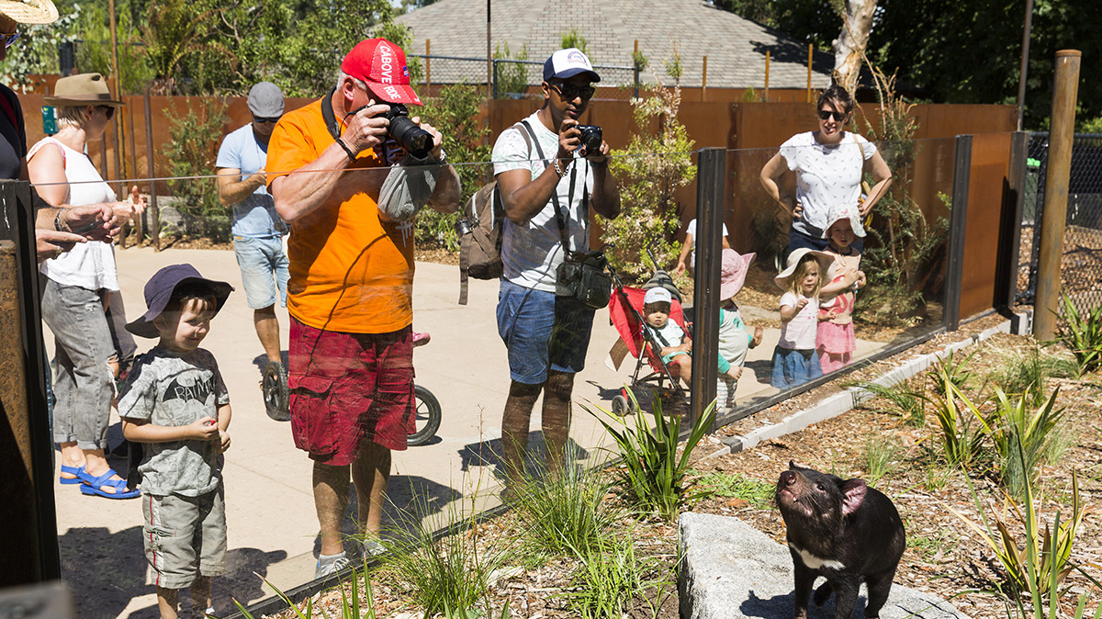
https://worldlandscapearchitect.com/urban-initiatives-creates-immersive-visitor-experience-at-melbourne-zoo/
Notes:
The biggest difference from wild animals and animals in a zoo and aquarium is the presence of visitors.
However, too many visitors themselves, loud noise from visitors, and camera flashes can be a stress factor for animals.
Each animal has different stress factors and different sensitivity.
Some animals are sensitive to the number of visitors, and others are sensitive to noise.
In order for zoos and aquariums not to be facilities that abuse animals, these stress factors must be managed.

Slide 4
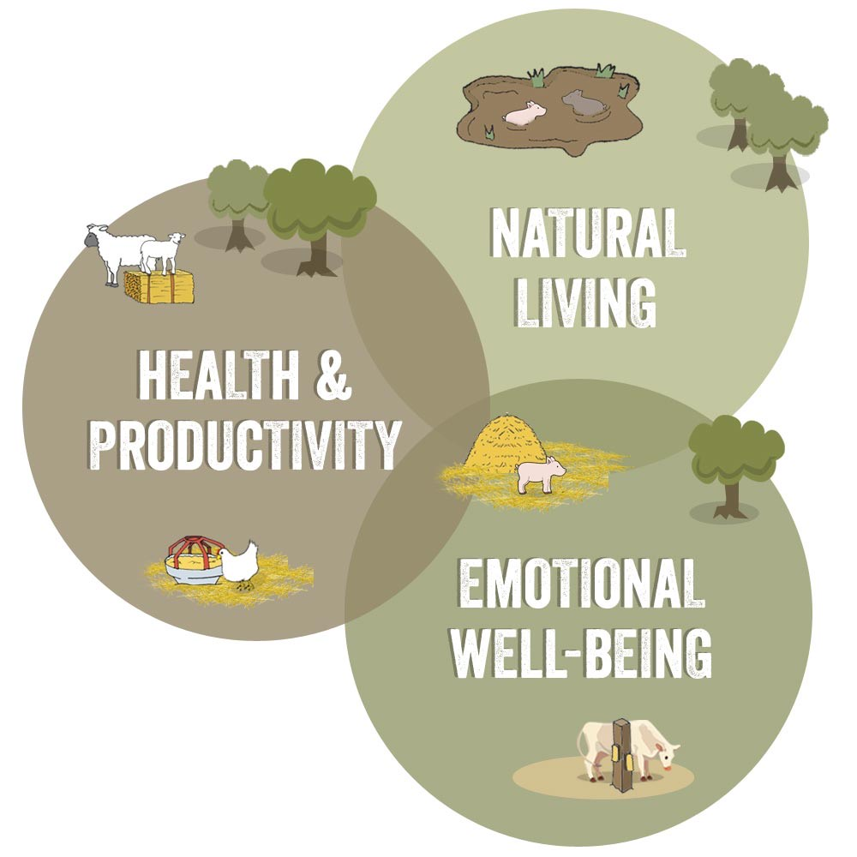
https://www.globalanimalpartnership.org/5-step-animal-welfare-rating-program
Notes:
There is Animal Welfare Science for that.
Animal welfare science can be applied to suit each animal's situation to raise their welfare level.
It considers these three; Natural Living, Health & Productivity, and Emotional Well-Being.
Animal welfare researchers consider the various characteristics of each animal and help them live happier and more satisfied.

Slide 5

Notes:
There is a World Association of Zoos and Aquariums. According to their official site, “their goal is to guide, encourage and support the zoos, aquariums and like‑minded organizations of the world in animal care and welfare, environmental education and global conservation.”

Slide 6
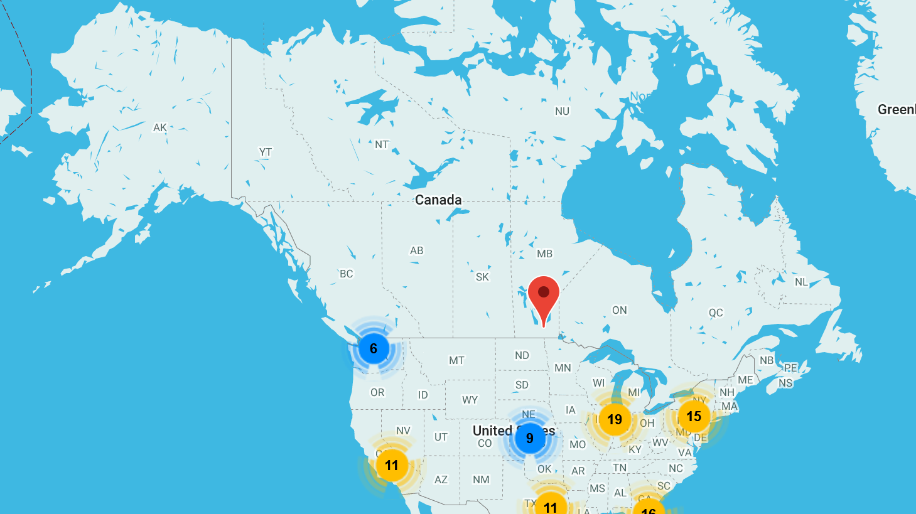
https://www.waza.org/members/find-a-waza-zoo-or-aquarium/
Notes:
To belong to the World Association of Zoos and Aquariums as a member, Animal welfare evaluation must be in place, and such processes must include specific elements approved by World Association of Zoos and Aquariums.
If you visit the World Association of Zoos and Aquariums site, you can find a map showing zoos and aquariums that implement animal welfare. If you look up this map before visiting a zoo or aquarium and make a decision to visit, you can contribute to the rights of animals.

Slide 7
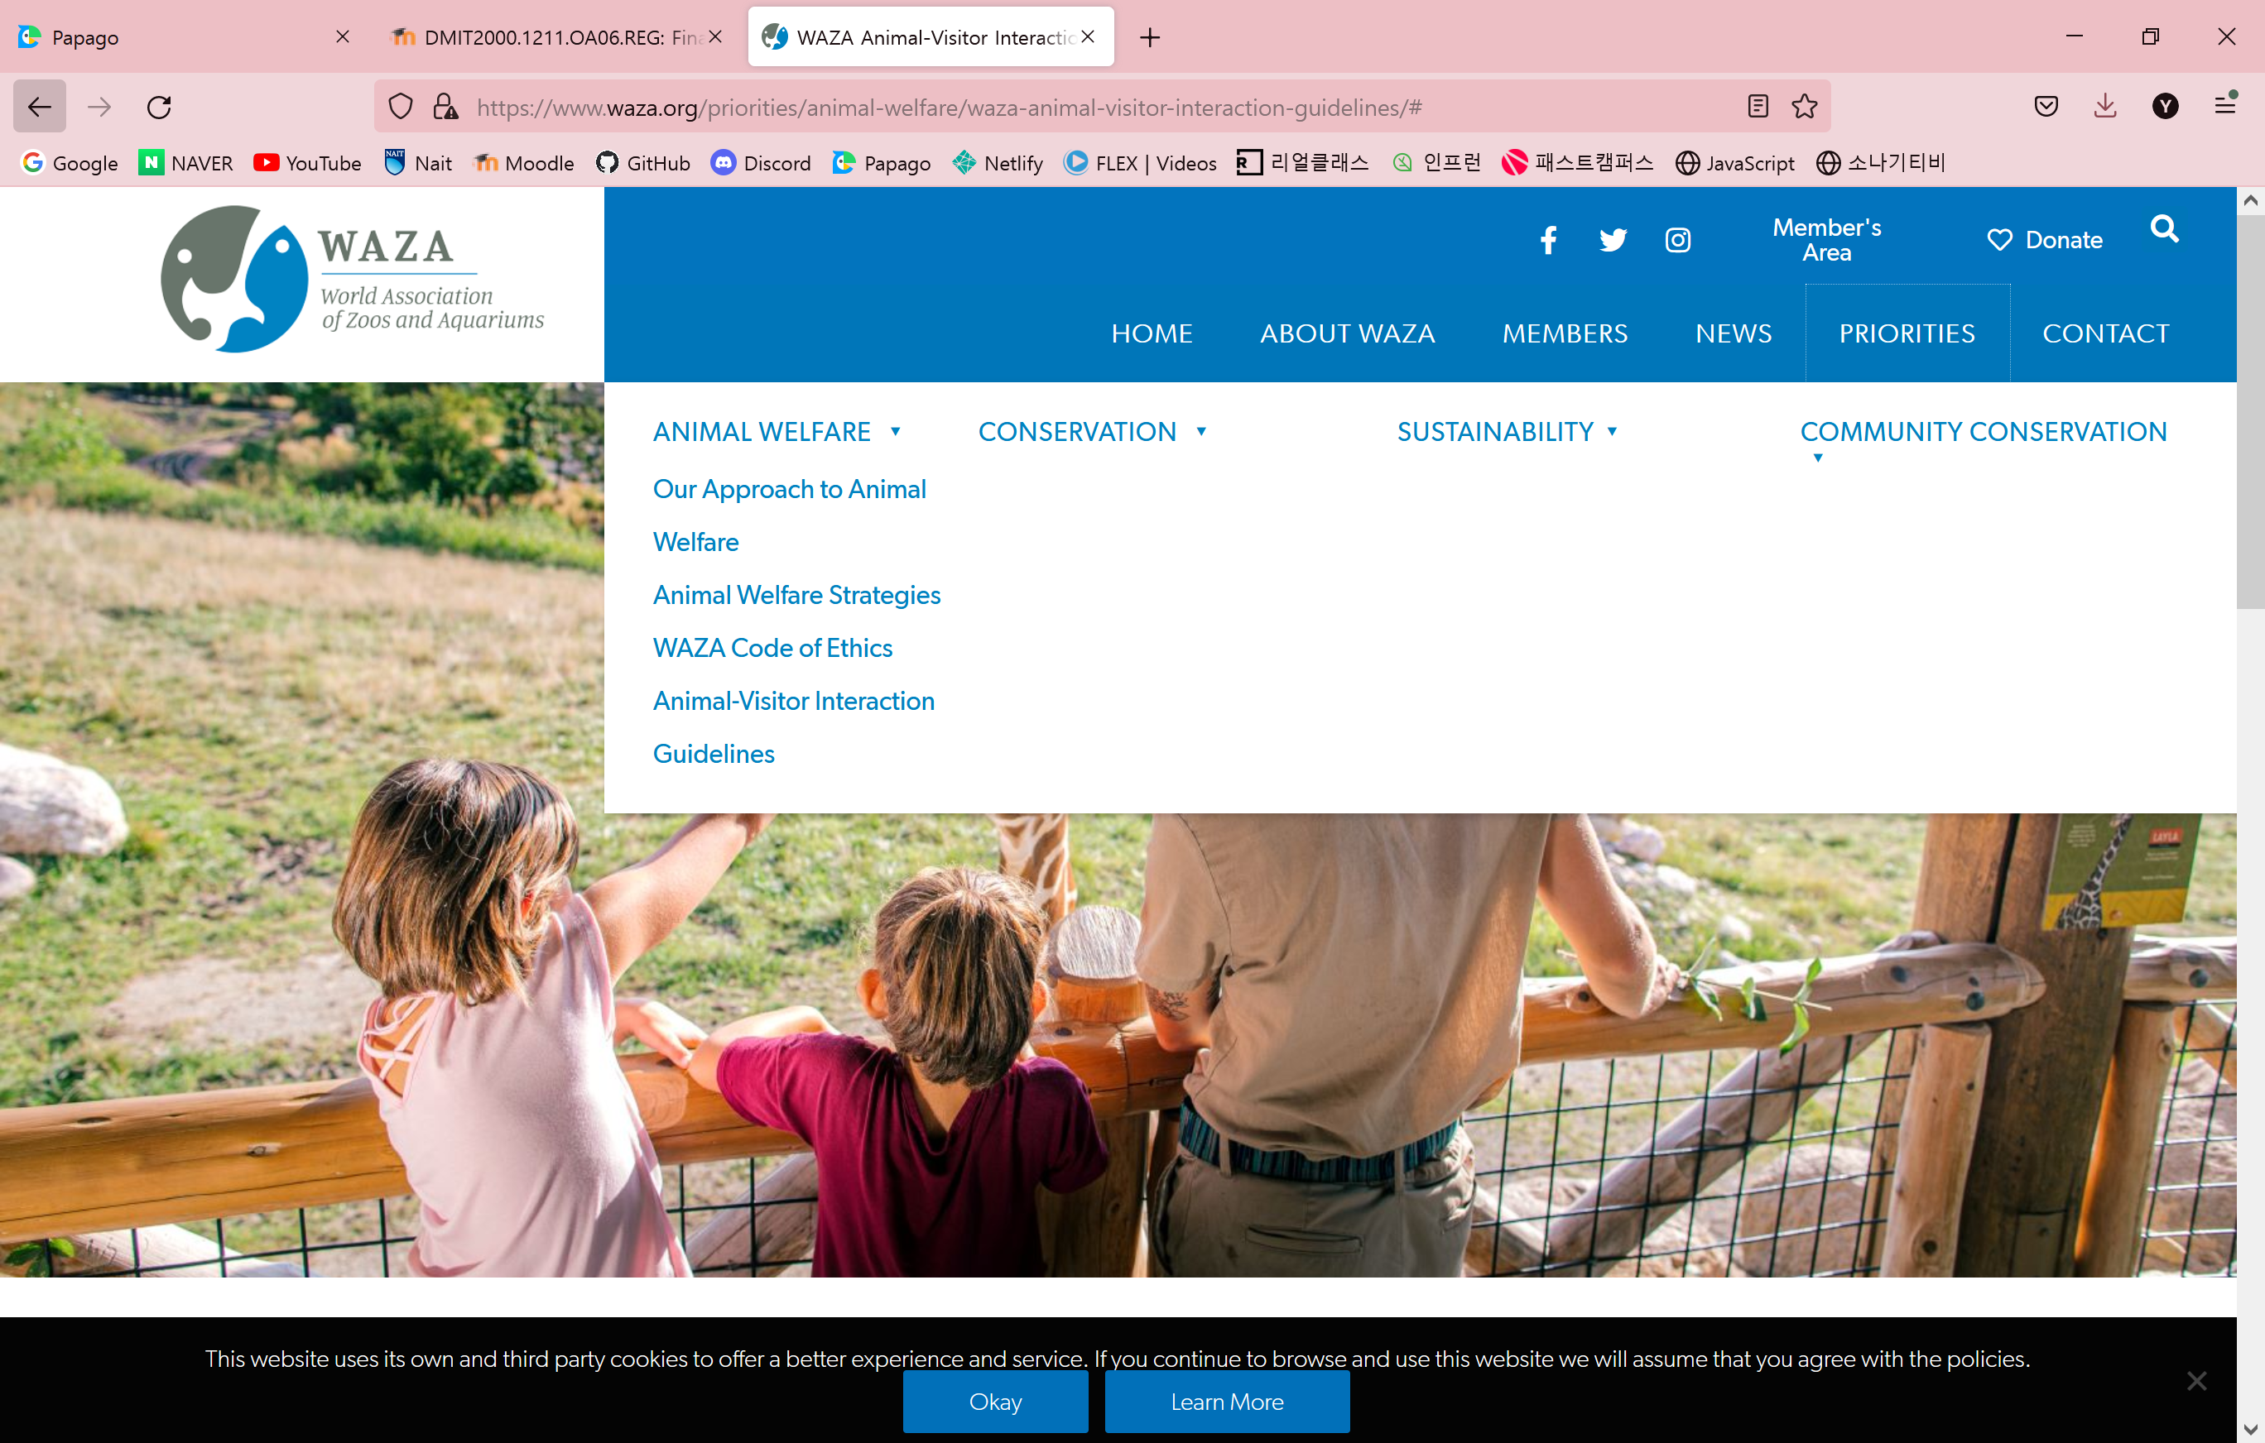
Notes:
Also the World Association of Zoos and Aquariums have Animal-Visitor Interaction Guidelines based on the scientific evidence in variety languages.
If people read this booklet before visiting the zoos and aquariums, it will be a fun time for both animals and humans.

Slide 8

https://www.smf.org.uk/government-regulation-and-todays-tech-giants-how-far-should-they-go/
Notes:
However, individual behavior alone cannot completely prevent abuse of animals in zoos and aquariums.
We need government regulations.
It is necessary to continuously check whether the living environment of animals is appropriate and the number of visitors to zoos and aquariums is maintained appropriately.
We must admit that displaying animals itself can be abuse and protect their rights by law.

Slide 9

https://www.forbes.com/sites/lealane/2021/03/03/saving-endangered-animals-talking-with-the-san-diego-zoo-wildlife-alliance-ceo/?sh=7e0af306146d
Notes:
The Earth is not just for humans. We must live together while protecting the rights of animals.

Slide 10

https://www.flaticon.com/free-icon/thank-you_1145941
Notes:
Thank you for listening my presentation today,

Slide 11

Question
https://www.flaticon.com/free-icon/problem_3240831
Notes:
And if you have any questions, feel free to ask!
Thank you ☺

Slide 12
Reference
The link for each image is in each slide.

